Slide 1
software for
financial & investment
maintenance

Slide 2
presented by
Balachandra P Hegde
Vittal desai
Sachin
Priyanka R Samal
Divya
Reshma
Radhalaxmi

Slide 3
About our project
Our project named financial and investment software for self employed professional is to develop a application software for implementing the investment and financial transaction for the professionals. The various types of professionals like doctors, engineers or other technical or non technical professionals. It is observed that many such are investing the finance in various schemes and financial growth or insurance sectors.
To keep track of such investments and the periodic reminders for periodic payments or receivables. Manual observations are time consuming and results in penalty payments.
To overcome such problems there is no such software available in general and most of the people depend on daily entries. Hence this project is useful for such professionals.

Slide 4
objectives
Maintain bank accounts
  SB
  FD
  RD
Maintain stocks.
  Mutual funds
  Shares
  Bonds
Maintain postal investments.
Maintain insurances.

Slide 5
Tools and platform
Front end:
Visual basic.net
Back end:
SQL server 2005
Hardware requirements:
Processor : Pentium 4, 1.8Ghz or higher
Ram : 512 MB/1GB or higher
Hard disk : 80GB or higher
Software requirements:
Operating system: Win-2000/XP/2003 or higher versions.
Database : MS-SQL server 2005.
Integrated development environment: Visual studio 2008/vb.net
External tools: Crystal reports.
Under the guidance of
Varsha phayde

Slide 6
Data flow diagram
Level 0
user
Enter
login
Reject
User name &
Password
authentication
Mismatch
Success
Main
system

Slide 7
Level 1
s.e.p home
s.e.p name
& id
Go to financial & investment entries
user
Enter
Select

Slide 8
Level 2
user
Enter
Mutual fund
Enter
Mfc no &
Comp. name
Checks
Record
Exists or
not
Not exists
Exists
Ask for
overwrite
Y/N
Create
new record
Re enter
No
Yes
Stores in
Open existing
Record
for editing
Mutual fund
Database
Stores in

Slide 9
Level 3
Mutual
fund
Report
Mature date
Check
Difference between system date
& due date is<6
Check
Report
Due date
Difference between system date
& due date is<6
Alerts

Slide 10
tables
login
FIELD NAME | DATATYPE | SIZE | DESCRIPTION
User name | nvarchar | 20 | User name
Password | Nvarchar | 20 | Password
Sb table
FIELD NAME | DATATYPE | SIZE | DESCRIPTION
Bank name | Nvarchar | 30 | Bank name
Bank address | Nvarchar | 50 | Bank address
SB account no. | Numeric | 18,0 | Account number
Date | Date | 8 | Date
Present balance | Numeric | 18,4 | Present balance
Credit | Numeric | 18,4 | Credit amount
Debit | Numeric | 18,4 | Debit amount

Slide 11
Fixed deposits
FIELD NAME | DATATYPE | SIZE | DESCRIPTION
Bank name | Nvarchar | 30 | Bank name
Holder | Nvarchar | 30 | Holder name
Nominee | Nvarchar | 30 | Nominee name
DOC | Date | 8 | Date of commencement (starting date)
DOM | Date | 8 | Date of maturity
Interest | Numeric | 18,4 | Interest value
Deposit amount | Numeric | 18,4 | Initial investment amount
Maturity amount | Numeric | 18,4 | Final returns
Receipt no. | nvarchar | 30 | Receipt number
Acct no. | nvarchar | 30 | Account number
Action taken | Nvarchar | 50 | Maturity action

Slide 12
Recurring deposits
FIELD NAME | DATATYPE | SIZE | DESCRIPTION
Bank name | Nvarchar | 30 | Bank name
Holder | Nvarchar | 30 | Holder name
Nominee | Nvarchar | 30 | Nominee name
DOC | Date |  | Date of commencement
DOM | Date |  | Date of maturity
Interest | Numeric | 18,4 | Interest value
Installment amt. | Numeric | 18,4 | Installment amount
Maturity amt. | Numeric | 18,4 | Maturity amount
Receipt no. | Nvarhar | 30 | Receipt number
Acct no. | Nvarchar | 30 | Account number
Action taken | Nvarchar | 50 | Action taken on maturity

Slide 13
Mutual fund
FIELD NAME | DATATYPE | SIZE | DESCRIPTION
Fund name | Nvarchar | 30 | Fund name
Holder | Nvarchar | 30 | Holder name
Nominee | Nvarchar | 30 | Nominee name
Folio | nvarchar | 30 | Fund account numbe
Bank details | Nvarchar | 100 | Bank details
since | date |  | First Investment date
No. of units | Numeric | 18,0 | Total no. of units
Cost initial | Numeric | 18,4 | Initial cost
Cost additional | Numeric | 18,4 | Additional cost
Nav | numeric | 18,4 | Net asset value (present value of the units)
Nav date | Date |  | Net asset value date
Mkt. value | Numeric | 18,4 | Market value
Dividend rcvd. | Numeric | 18,4 | Dividends received
Action taken | Nvarchar | 30 | Maturity action
Action date | Date |  | Action taken date

Slide 14
shares
FIELD NAME | DATATYPE | SIZE | DESCRIPTION
Dp. Name and id | Nvarchar | 50 | Depository name and id
Client id | nvarchar | 30 | client id
Comp. name | Nvarchar | 50 | Company name
No. of shares | Numeric | 18,0 | Number of shares
Face value | Numeric | 18,0 | Face value
Market value | Numeric | 18,0 | Market value
Transaction | nvarchar | 30 | Transaction made
Trn Date | Date | 8 | Date of transaction

Slide 15
bonds
FIELD NAME | DATATYPE | SIZE | DESCRIPTION
F_Name | Nvarchar | 30 | Fund name
Holder | Nvarchar | 20 | Holder name
Nominee | Nvarchar | 20 | Nominee name
Folio | nvarchar | 30 | Fund account number
B_details | Nvarchar | 50 | Bank details
No. of bonds | Numeric | 18,0 | Total no. of bond
Cost initial | Numeric | 18,4 | Initial cost
Cost additional | Numeric | 18,4 | Additional cost
DOC | Date | 8 | Date of commencement
DOM | Date | 8 | Date of maturity
Maturity val | Numeric | 18,4 | Maturity value
Action taken | Nvarchar | 30 | Maturity action
Date | Date | 8 | Date of action taken

Slide 16
insurance
FIELD NAME | DATATYPE | SIZE | DESCRIPTION
Company | Nyarchar | 30 | Company name
Nominee | Nvarchar | 30 | Nominee name
Policy no. | nvarchar | 30 | Policy number
Table-term | nvarchar | 30 | Table-term
Premium | Numeric | 18,4 | Premium amount
Periodicity | nvarchar | 30 | Periodicity
DOC | Date | 8 | Date of commencement
DOM | Date | 8 | Date of maturity
Sum assured | Numeric | 18,4 | Assured sum
Prem status | Nvarchar | 30 | Premium status
F_value | Numeric | 18,0 | Fund value
F_date | Date | 8 | Fund date
Survival benefits | Numeric | 18,0 | Survival benefits received

Slide 17
Postal investments
FIELD NAME | DATATYPE | SIZE | DESCRIPTION
PO_Name | Nvarchar | 30 | Post office name
Nature of invs | Nvarchar | 40 | Nature of investment
Deposit amt. | Numeric | 18,4 | Deposit amount
Maturity value | Numeric | 18,4 | Maturity value
DOC | Date | 8 | Date of commencement
DOM | Date | 8 | Date of maturity
Maturity amt | Numeric | 18,4 | Maturity amount
Installment periodicity | nvarchar | 30 | Period of installment
Action taken | Nvarchar | 30 | Maturity action

Slide 18
Private financial institution
FIELD NAME | DATATYPE | SIZE | DESCRIPTION
Ins_Name | Nvarchar | 30 | Name of institution
Investment | Numeric | 18,0 | Investment made
DOC | Date | 8 | Date of commencement
DOM | Date | 8 | Date of maturity
Maturity amt | Numeric | 18,4 | Maturity amount
Action taken | Nvarchar | 30 | Maturity action
Action date | Date | 8 | Maturity date

Slide 19
LOANS
FIELD NAME | DATATYPE | SIZE | DESCRIPTION
Loan nature | Nvarchar | 30 | Nature of loan
DOC | Date | 8 | Date of commencement
From whom | Nvarchar | 30 | Name of the person who gives the loan
Interest | Numeric | 18,4 | Interest
Installments | Numeric | 18,4 | Installment
Principal amount | Numeric | 18,4 | Principal amount
Maturity date | date | 8 | Date of maturity
Final action | Nvarchar | 30 | Maturity action
Date | Date | 8 | Date of final action taken

Slide 20
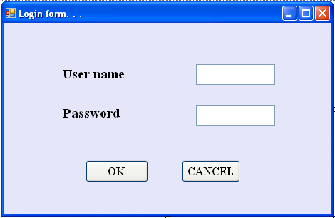
forms
login

Slide 21
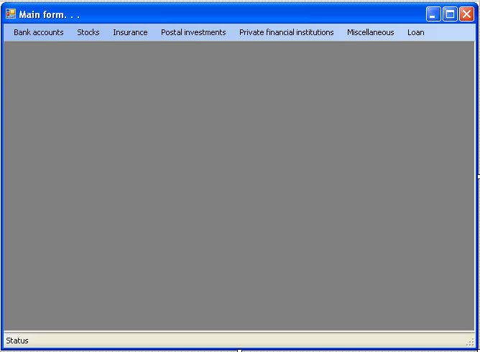
Mdi form

Slide 22
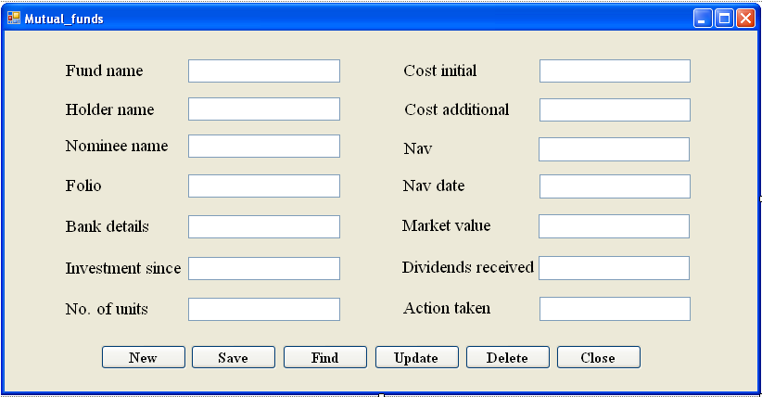
MUTUAL FUNDS

Slide 23
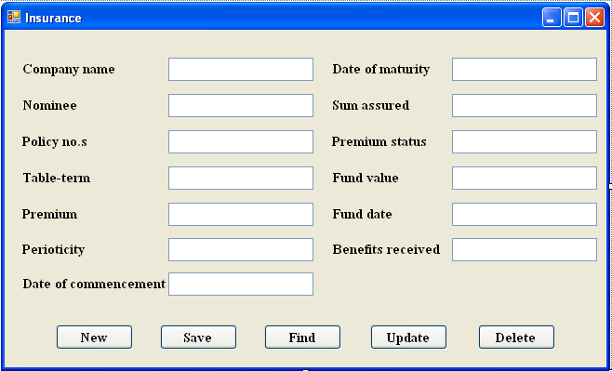
INSURANCE

Slide 24
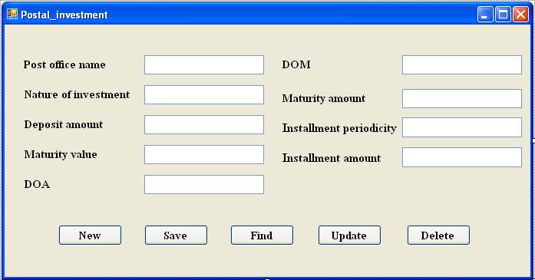
POSTAL INVESTMENTS

Slide 25
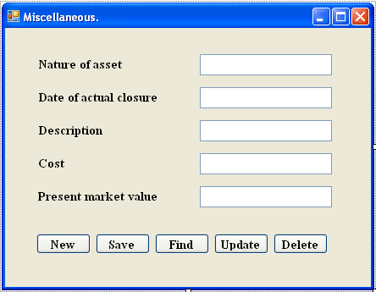
MISCELLANEOUS BONDS

Slide 26
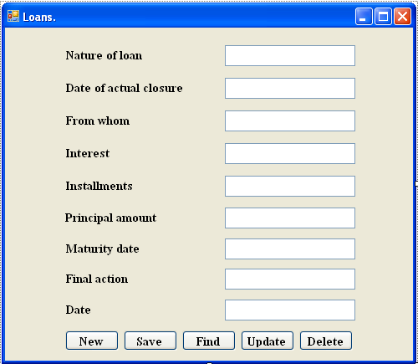
LOANS

